Slide 1
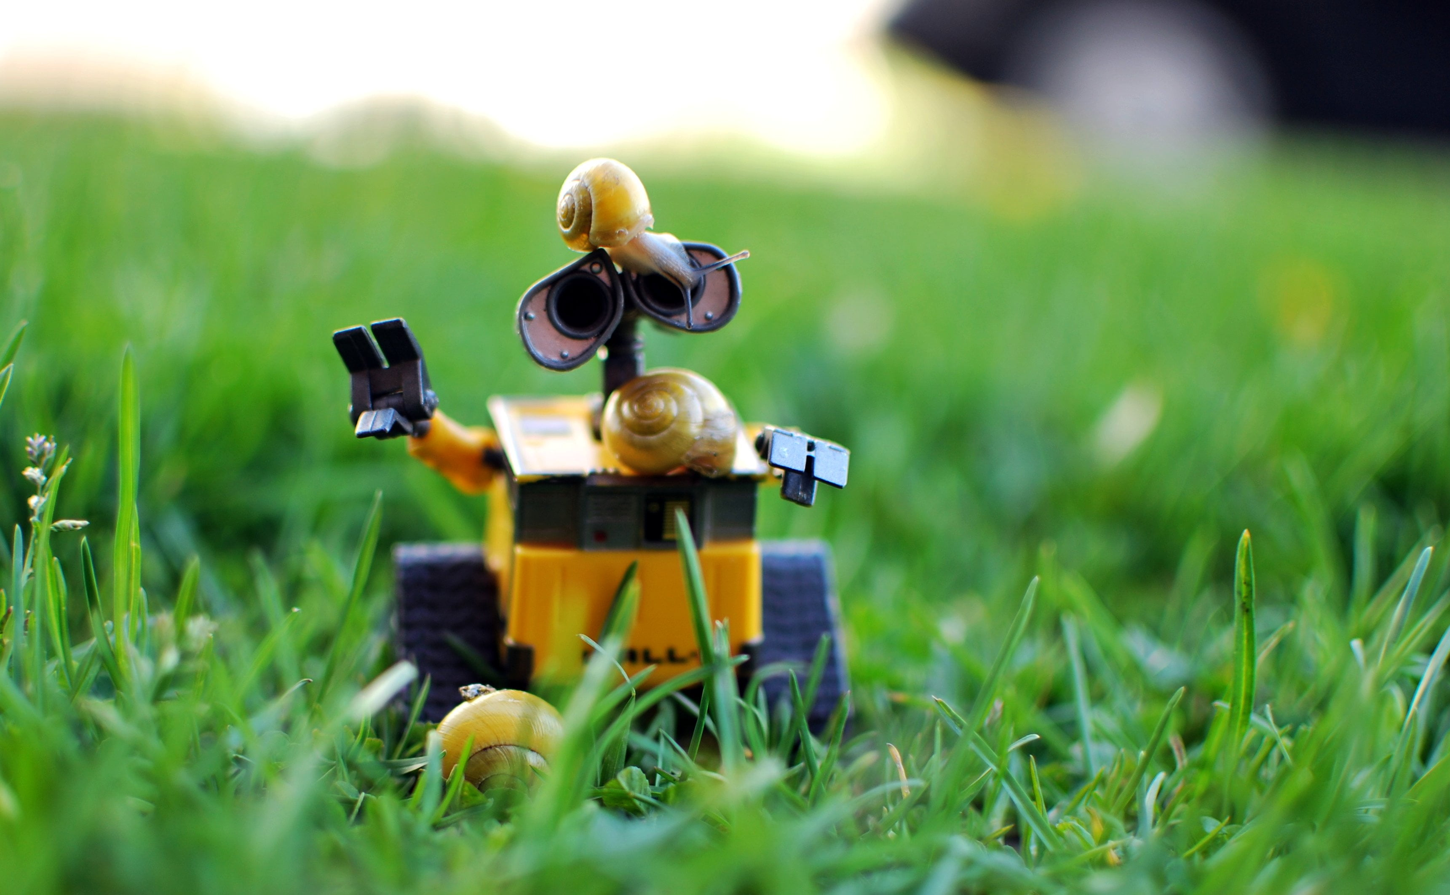
Precision Farming
Team-4
Neaz Mahmud
MOSHIOUR RAHMAN PRINCE
Abdullah Al Forkan

Slide 2

DIAGRAMS

Slide 3
Block Definition Diagram
Bdd [package] Precision Farming Robot
<<domain>>
RobotDomain
Interaction
LineFollower
ColorDetection
ObjectDetection
ObjectGrabbing
<<system>>
Robot Car
<<external>>
hay
<<external>>
Environment
<<external>>
Track
<<external>>
Lighting
<<external>>
Weather

Slide 4
Internal Block Diagram
Bdd [block] Robot Car Breakdown
<<system>>
Robot Car
P
M
C
Md
S
Power Supply
{{constraint} voltage>11.1V}
Microcontroller
Chasis
{{constraint} Dimensions<=250×200mm}
Motor driver
<<system>>
Sensors
A
Arduino Uno
{{constraint} Dimensions= 68.6×53.5mm}
Mo
Mo
Motor-1
{{constraint} Dimensions=37×72mm}
Motor-2
L
So
LiPo
Solar
I
US
CS
IR
Ultrasonic Sensor
Color Sensor

Slide 5
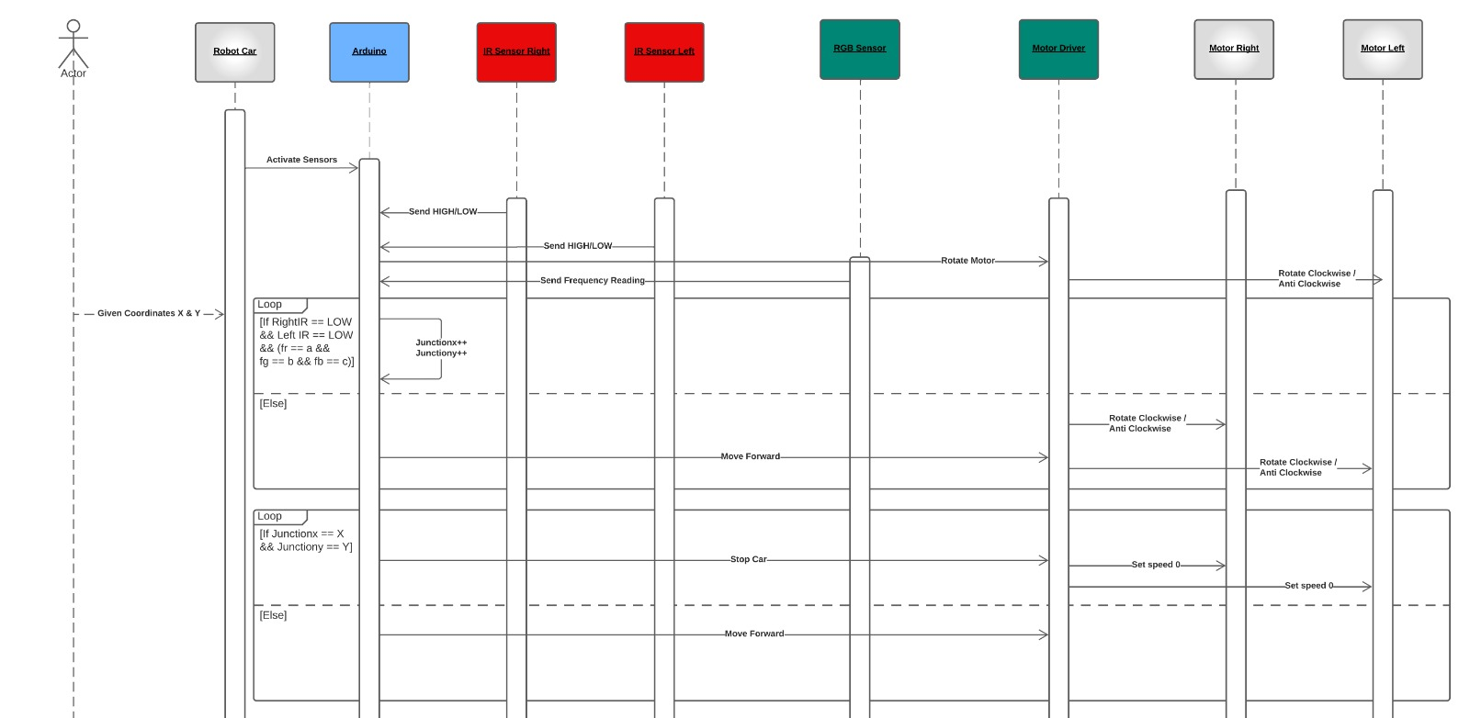
Sequence Diagram

Slide 6
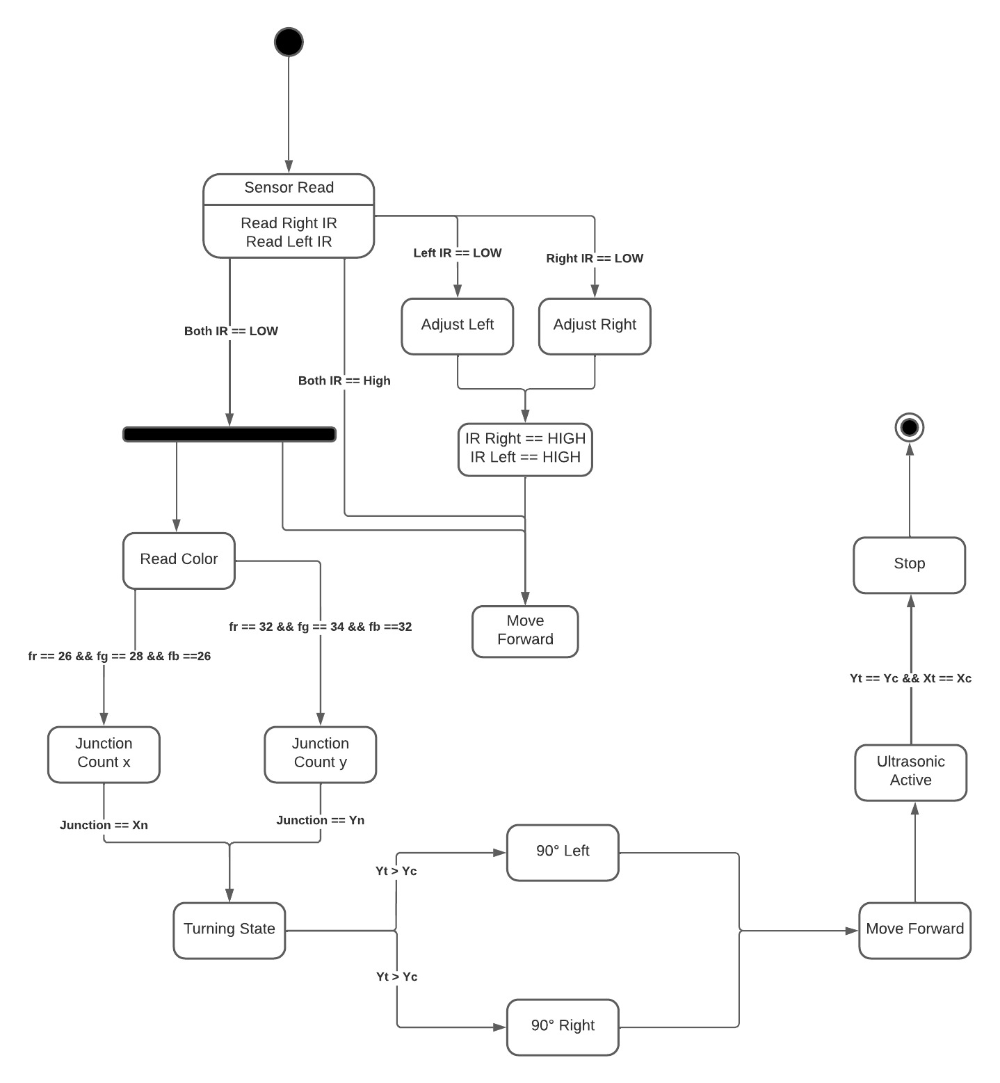
State Machine Diagram

Slide 7
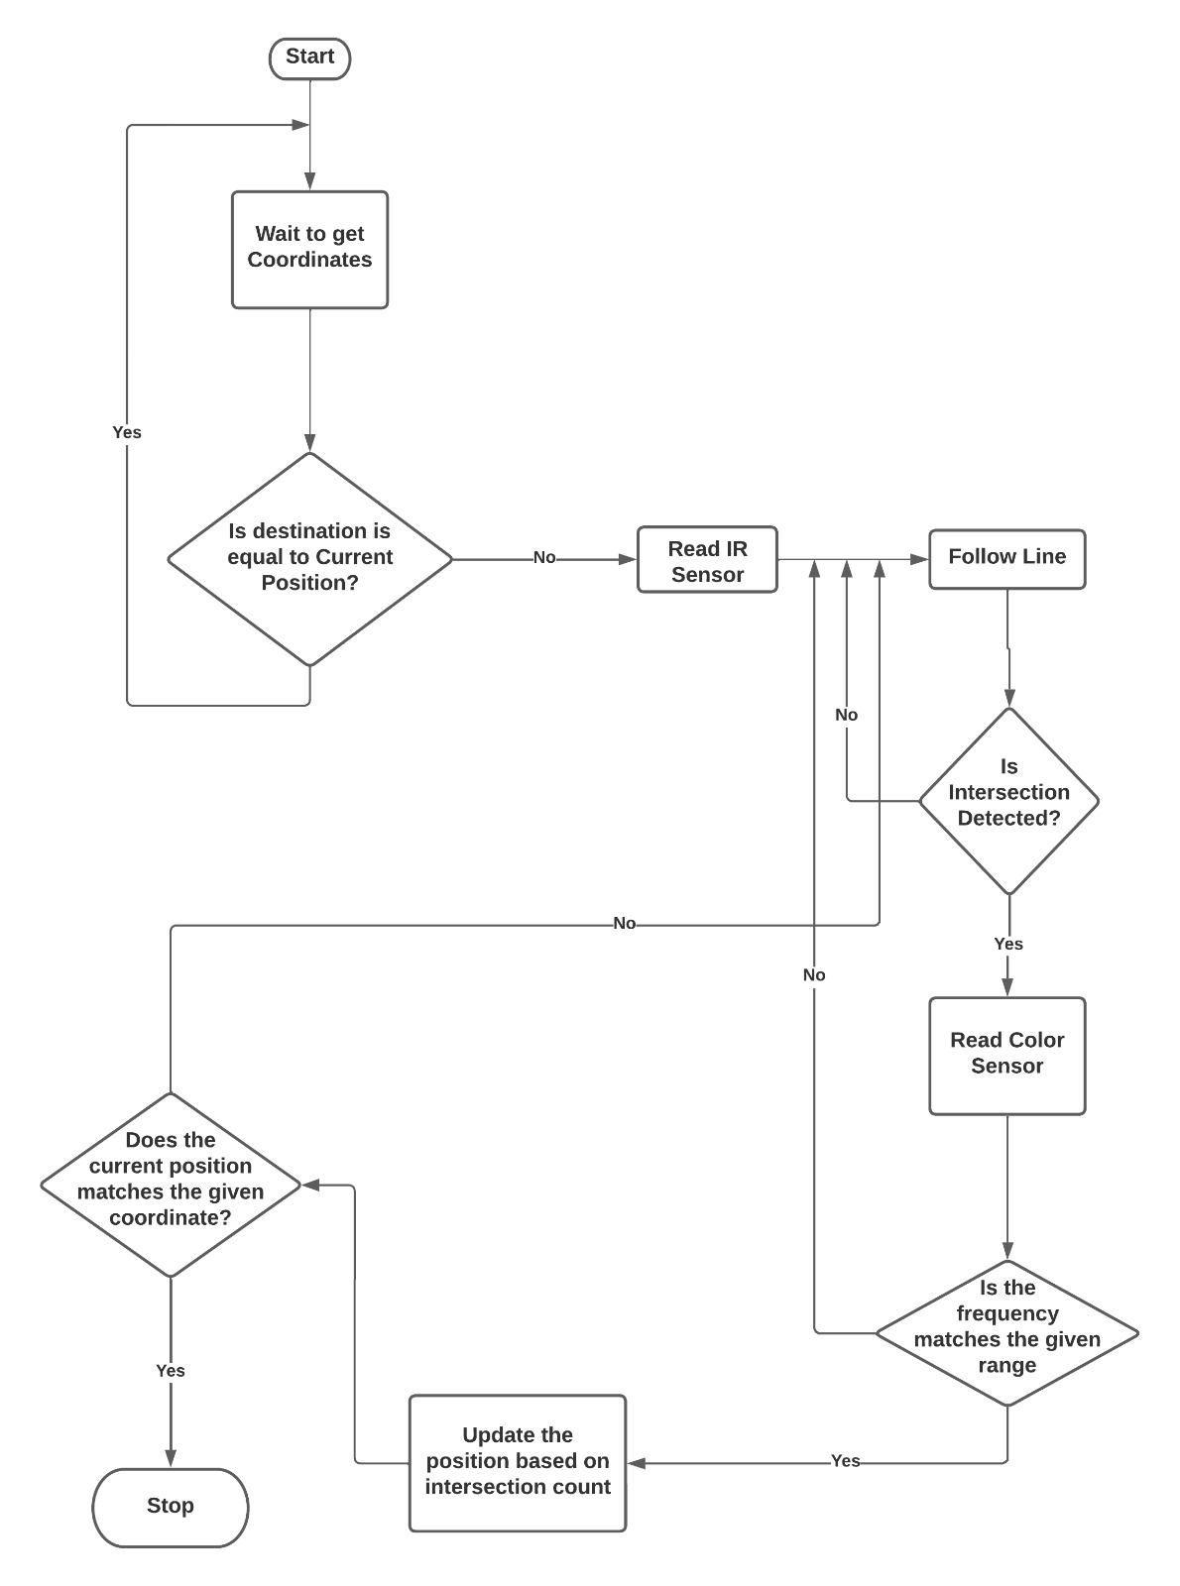
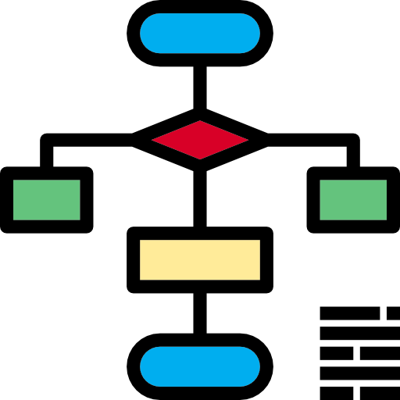
Flow Chart

Slide 8

DESIGN

Slide 9
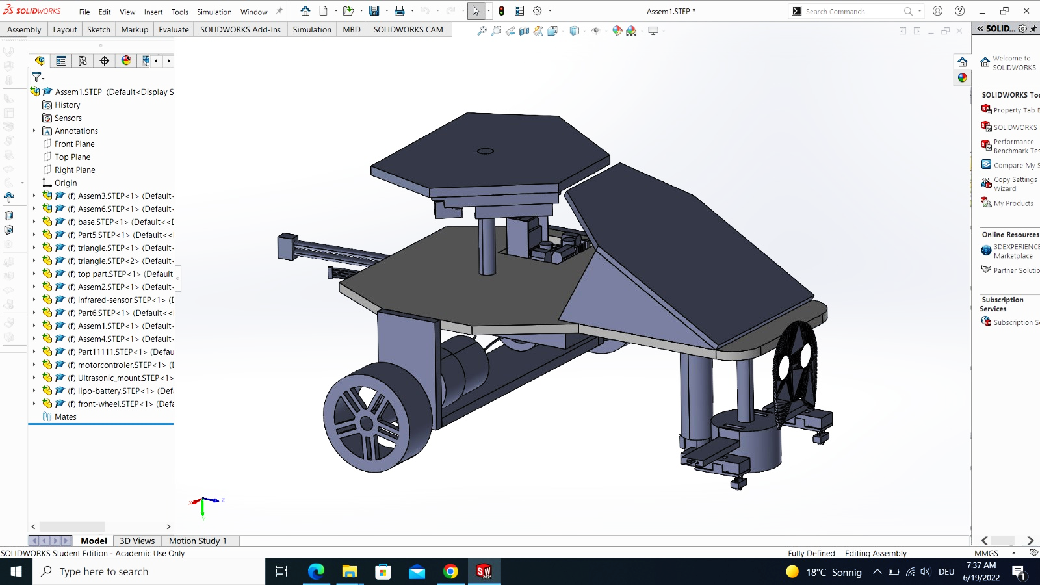
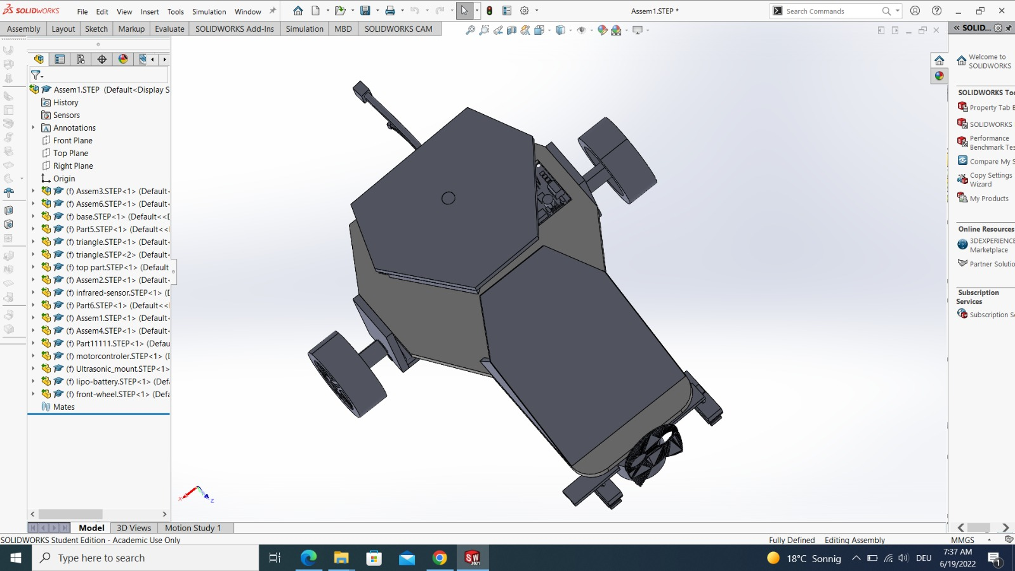
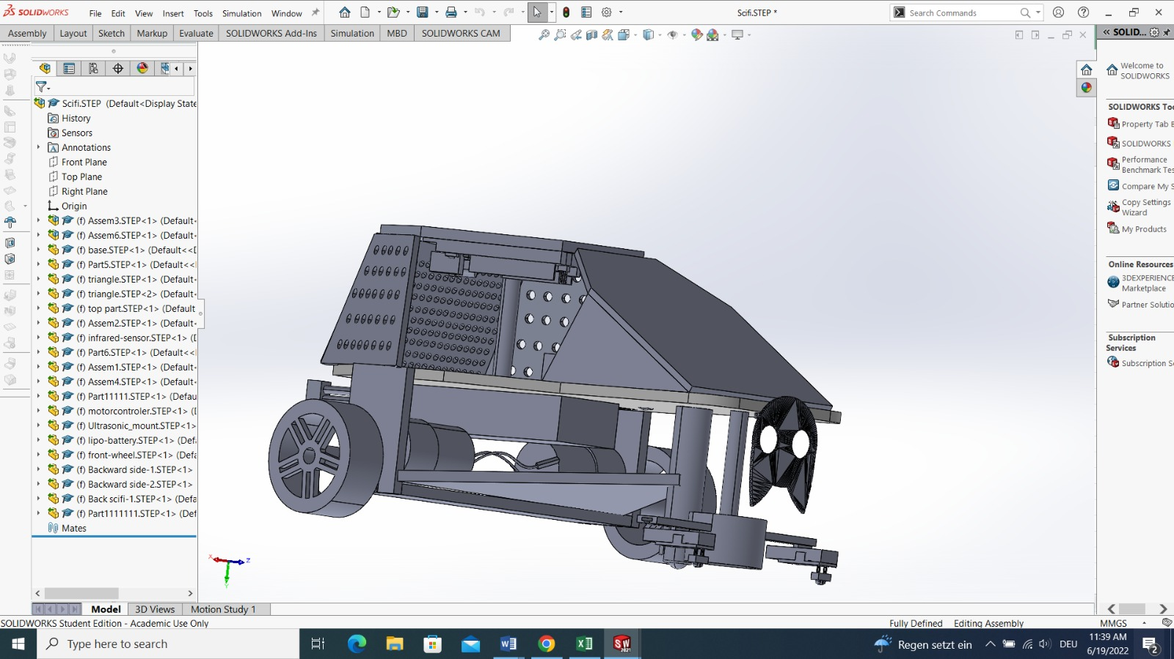
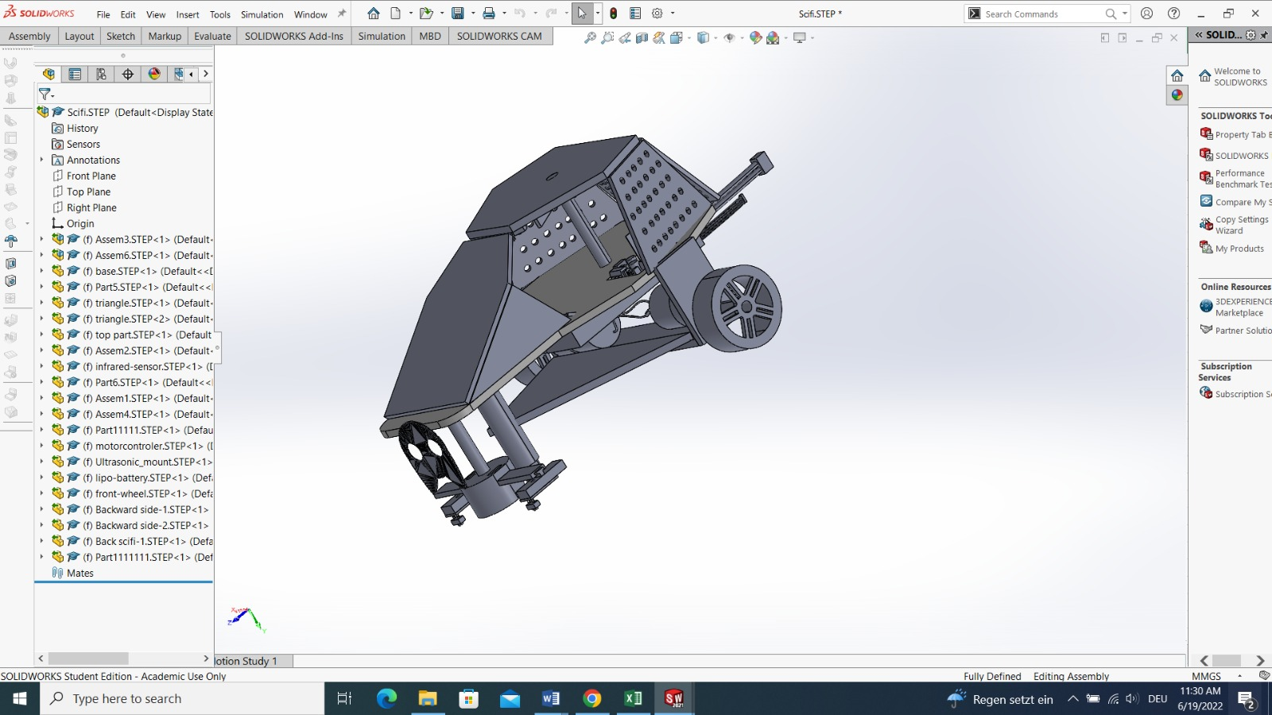

Slide 10
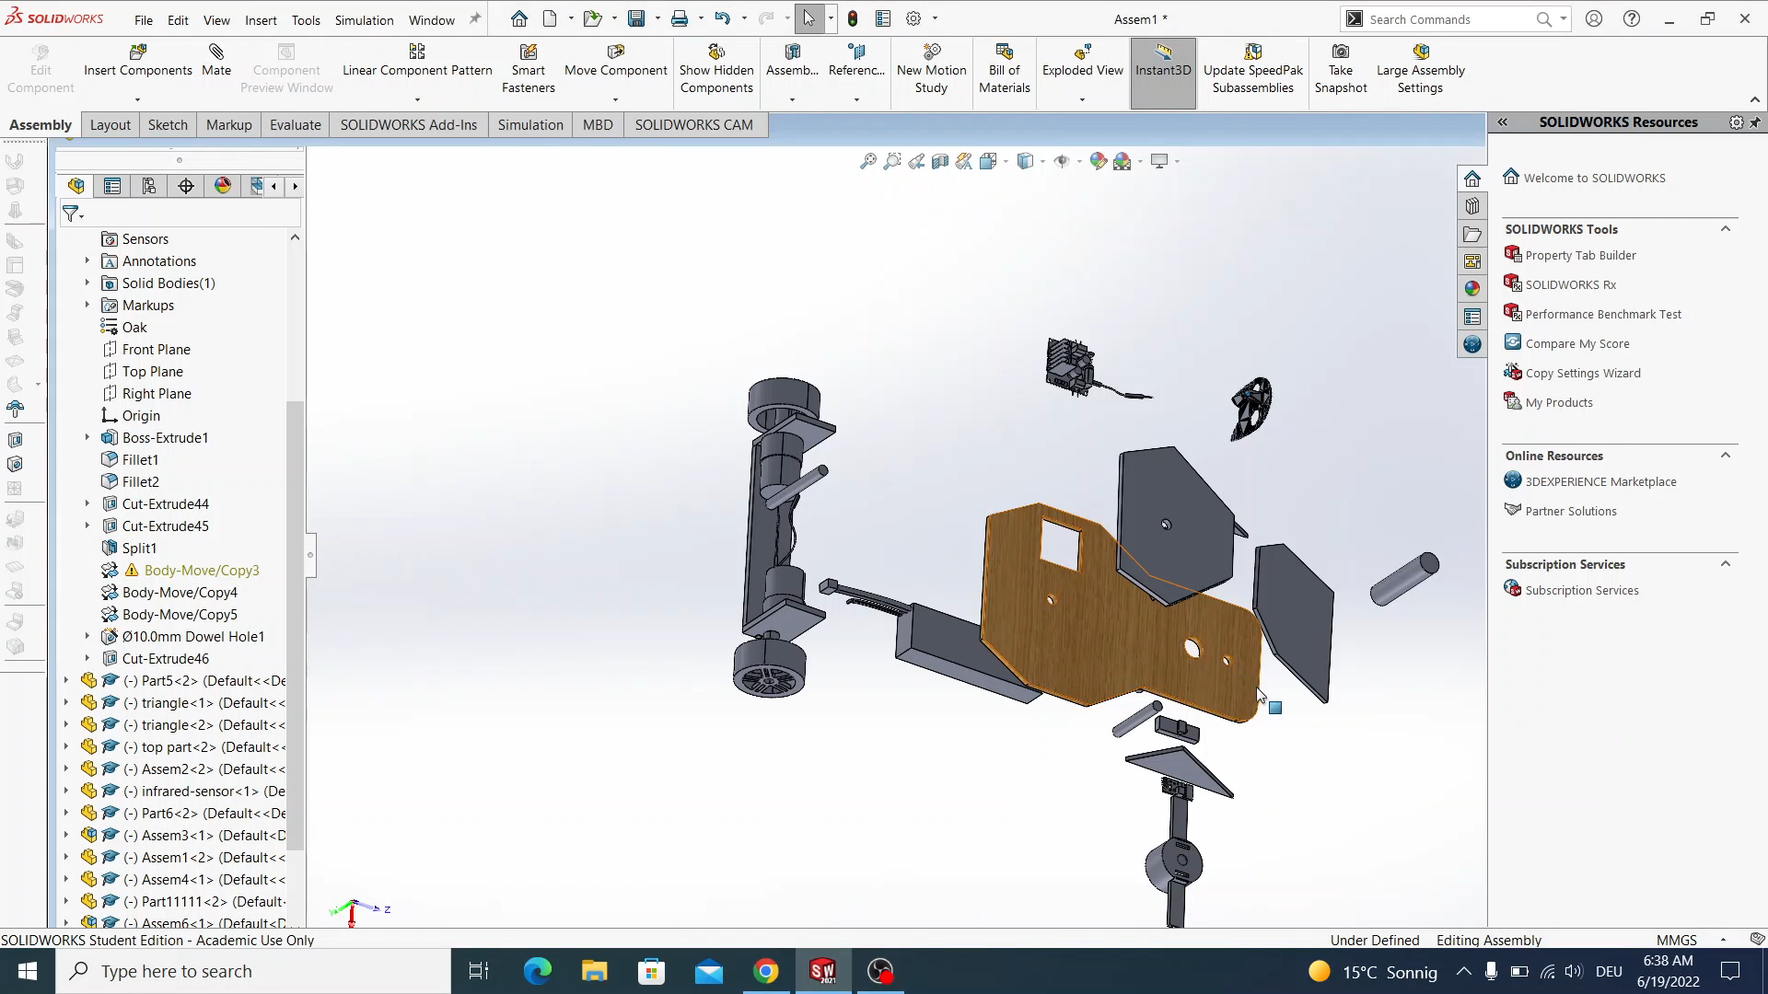

Slide 11

PROGRAMMING

Slide 12
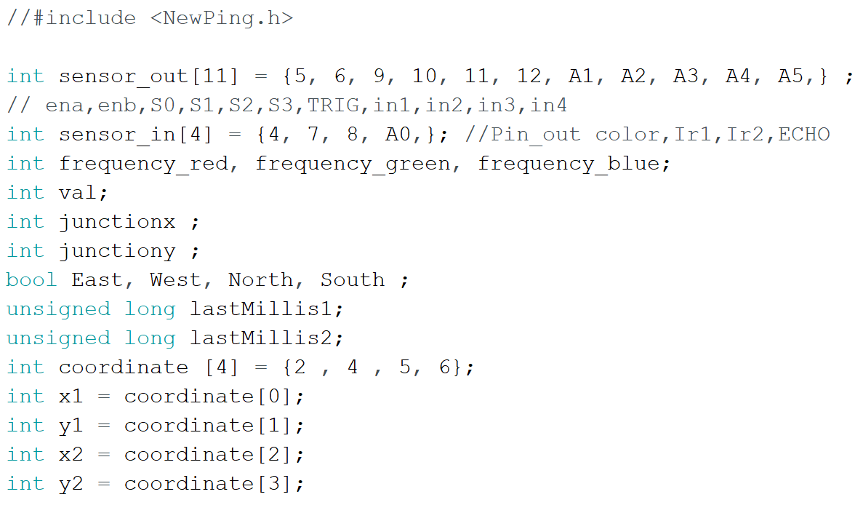
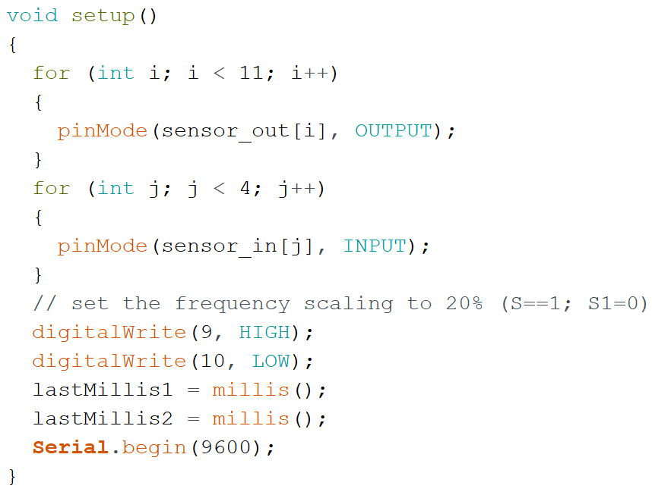
Arduino C Programming

Slide 13
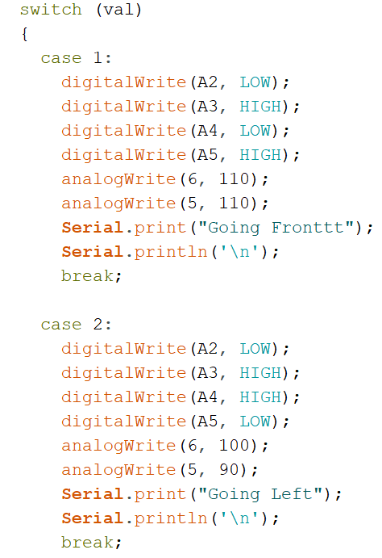
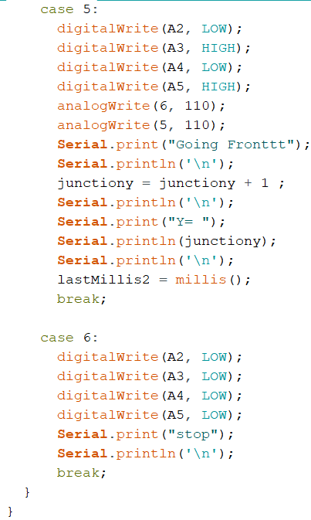
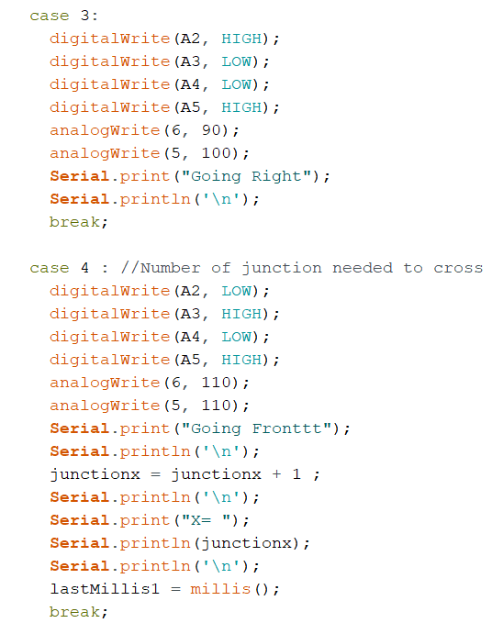

Slide 14
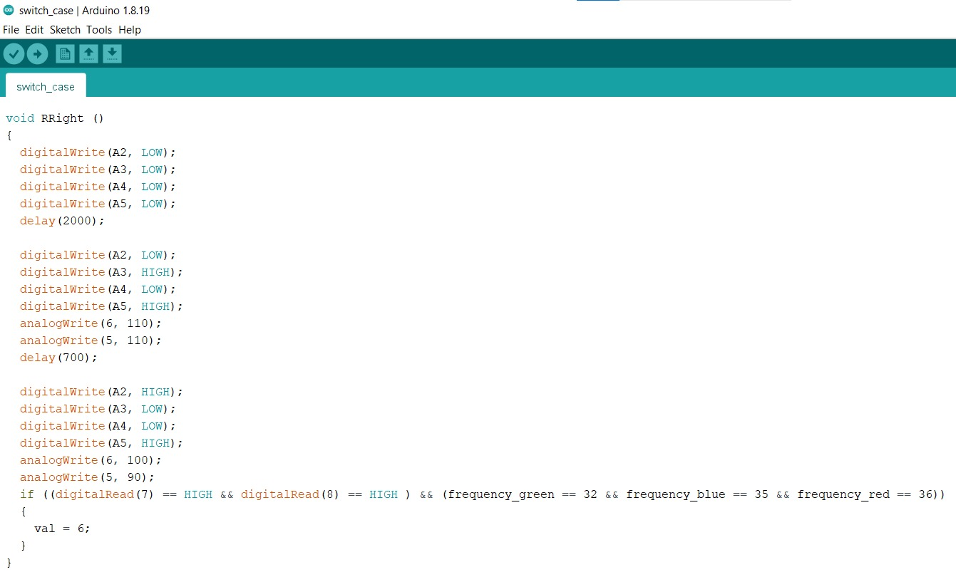

Slide 15
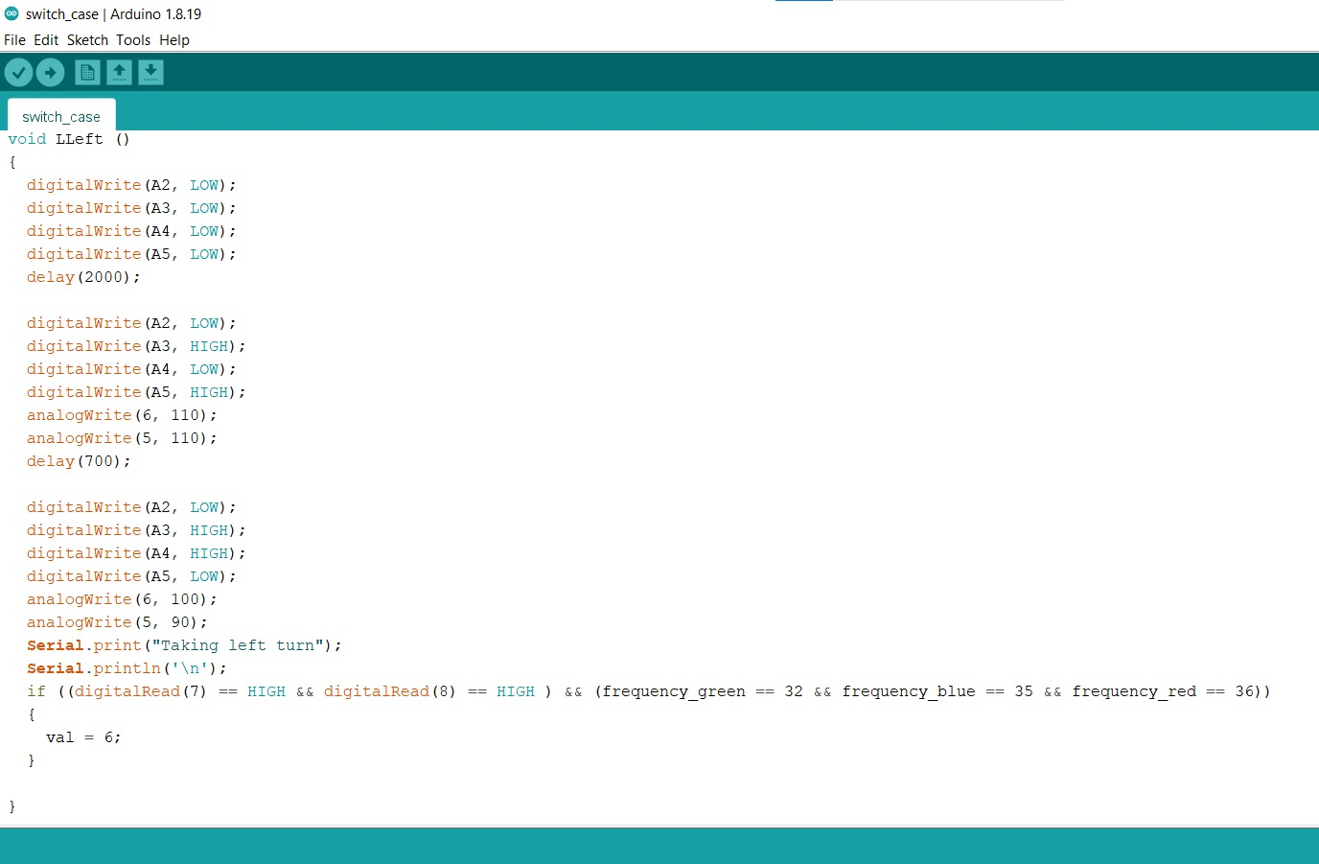

Slide 16
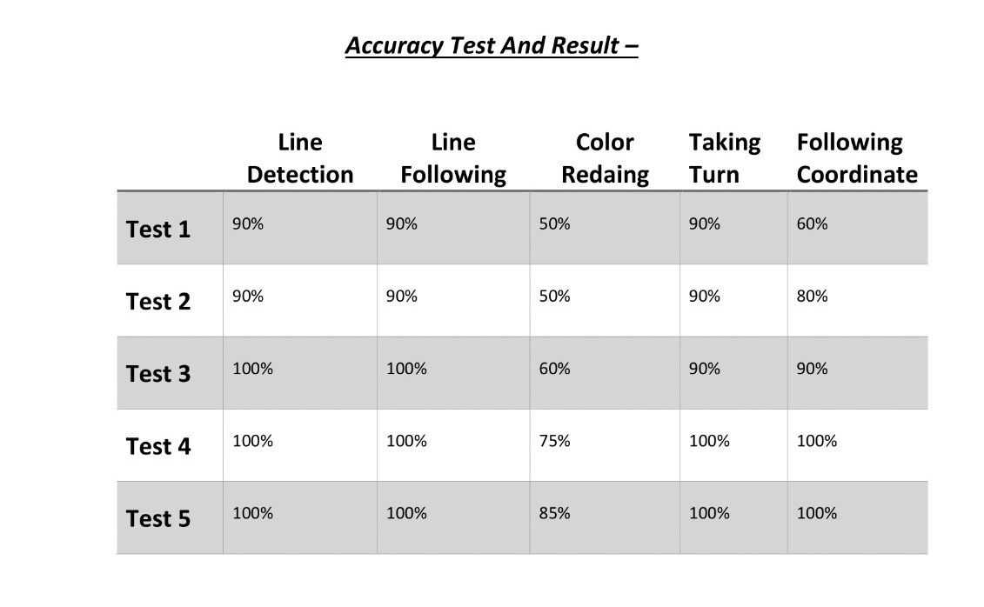


Slide 17
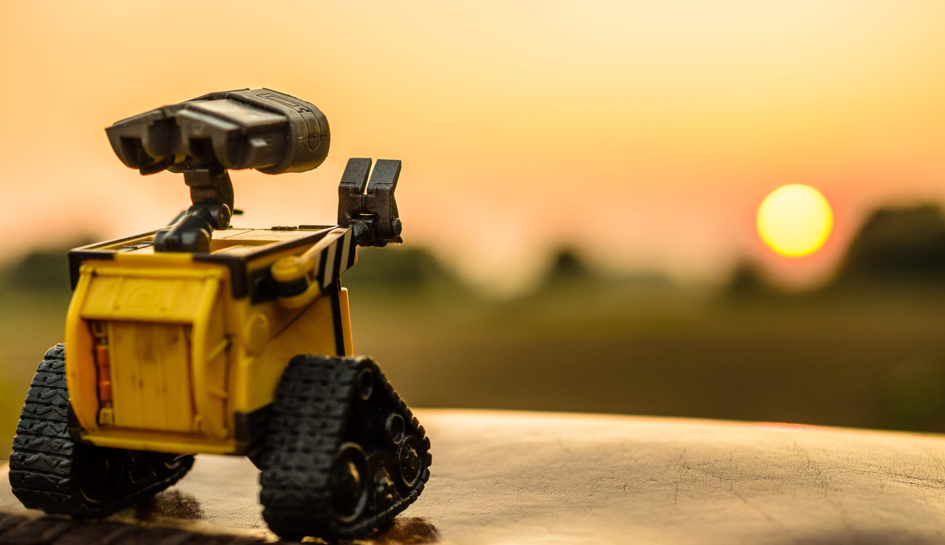
THANK YOU
Do You Have Any Questions?

